Slide 1
Module 4: Using Service Broker

Slide 2

Overview
Service Broker Architecture
Using Service Broker

Slide 3
Lesson: Service Broker Architecture
What Is Service-Oriented Architecture?
Service Broker Features
Service Broker System Architecture
Service Broker Conversation Architecture
Service Broker Conversation Process
Service Broker Security Architecture

Slide 4




What Is Service-Oriented Architecture?
Loosely coupled communication between services
Examples of service-oriented architectures:
Web Services
Message Queuing

Slide 5
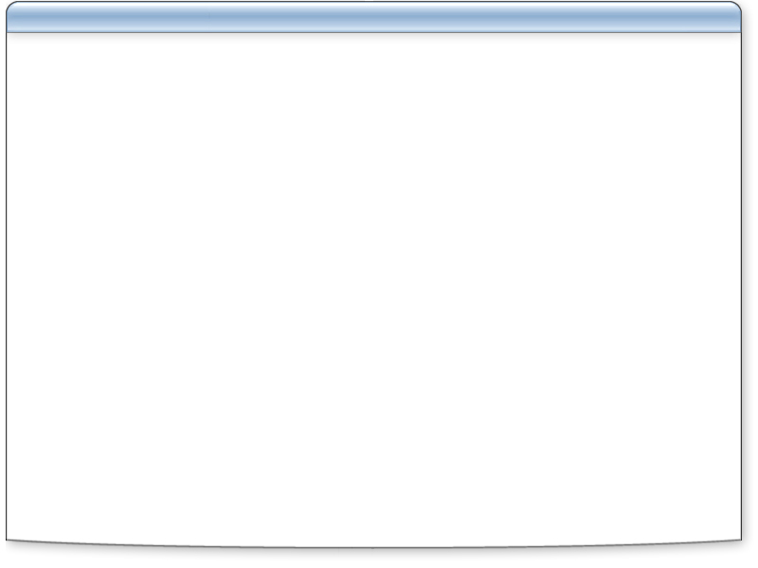





Service Broker Features
Secure communication
Database integration
Automatic service program activation
Scheduling and processing flexibility
Asynchronous delivery using queuing
Messages received once and in correct order
Related messages coordinated using conversations
1
2
3
1
A1
2
A2
3
Queue
Transactional
messaging
Messages stored
in database
3
2
1
B1
B2
Queue
Service Consumer
Queue
Service Provider
Queues maintained
in database

Slide 6
Service Broker System Architecture
SQL Server Object | Description
Message Type | Defines valid messages for exchange between services
Contract | Specifies type of messages and their direction in a conversation, initiator or target
Queue | Stores messages before sending and after receipt as result set
Service Program | The part of a service broker application that reads messages from a queue and processes them.
Service | Addressable endpoint for service communication
Message type
Queue
Contract
Service
Service program

Slide 7
Service Broker Conversation Architecture
Construct | Description
Dialog | Conversations that involve messages being sent and received by two services, ensuring exactly-once-in-order (EOIO) delivery Dialog continues until explicitly ended or error occurs
Service Instance | Identifies a group of related conversations with a unique identifier Only one service program at a time can read messages with the same service instance identifier
Route | Used to direct conversations between different SQL Server instances A combination of a network address and an optional service name
Remote Service Binding | Associates a local database user with the name of a remote service

Slide 8


Service Broker Conversation Process
ProcessExpense Contract
ExpenseClaim
Message Type (Initiator)
ClaimResponse
Message Type (Target)
SubmitExpense Service
ProcessExpense Service
ExpenseQueue queue
ExpenseClaim
message
ExpenseQueue queue
3
msg
msg
msg
msg
7
ClaimResponse
message
8
6
4
2
ExpenseResult
Stored Procedure
ProcessExpense
Stored Procedure
SubmitExpense
Stored Procedure
5
1
Employee submits expense using client application
Conversation begins; Submit message sent asynchronously, stored procedure exits
Submit message received at target
ProcessExpense service program activated
ProcessExpense stored procedure processes message
AcceptedOrDenied and EndDialog messages sent,
ending conversation
AcceptedOrDenied message received
ExpenseSubmission service program activated;
conversation ends
1
2
3
4
5
6
7
8

Slide 9



Service Broker Security Architecture
Dialog Security
Transport Security
InitiateSvc
Transport Security
TargetSvc
master.TgtDbo
master.dbo
master.dbo
master.IniDbo
Dialog Security
DB1.TgtUsr
DB2.TgtUsr
Remote Service Binding
TgtUsr:TargetSvc
Remote Service Binding
IniUsr:InitiateSvc
DB1.IniUsr
DB2.IniUsr

Slide 10
Lesson: Using Service Broker
How to Enable Service Broker in a Database
Implementing Services
How to Create Contracts
How to Create Queues
How to Create Services
How to Send a Message
How to Receive a Message

Slide 11
How to Enable Service Broker in a Database
Check Service Broker status
1
SELECT is_broker_enabled
FROM sys.databases
WHERE database_id = db_id()
Enable Service Broker
2
ALTER DATABASE AdventureWorks
SET ENABLE_BROKER

Slide 12

Implementing Services
Design:
Message types
Contracts
Queues
Services
Service program logic

Slide 13
How to Create Contracts
Create message types
1
CREATE MESSAGE TYPE
[//Adventure-Works.com/Expenses/ExpenseClaim]
VALIDATION = WELL_FORMED_XML
CREATE MESSAGE TYPE
[//Adventure-Works.com/Expenses/ClaimResponse]
VALIDATION = VALID_XML WITH SCHEMA COLLECTION awschemas
Create contract
2
CREATE CONTRACT
[//Adventure-Works.com/Expenses/ProcessExpense]
( [//Adventure-Works.com/Expenses/ExpenseClaim]
SENT BY INITIATOR,
[// Adventure-Works.com/Expenses/ClaimResponse]
SENT BY TARGET )

Slide 14
How to Create Queues
Create queue name
1
Choose whether queue is available
2
Specify any activation parameters
3
CREATE QUEUE ExpenseQueue
CREATE QUEUE ExpenseQueueWithActivation
WITH STATUS = OFF,
ACTIVATION (
PROCEDURE_NAME = ProcessExpense, MAX_QUEUE_READERS = 5,
EXECUTE AS SELF)

Slide 15
How to Create Services
Create service name
1
Choose storage queue
2
List contracts for which the service is a target
3
Choose whether to retain messages for conversation lifetime
4
CREATE SERVICE [//Adventure-Works.com/SubmitExpense]
ON QUEUE ExpenseQueue
( [//Adventure-Works.com/Expenses/ProcessExpense] )

Slide 16
How to Send a Message
Declare a dialog handle variable
1
Begin a dialog conversation
2
Send the message
3
DECLARE @dialog_handle uniqueidentifier
DECLARE @dialog_handle uniqueidentifier
BEGIN DIALOG CONVERSATION @dialog_handle
FROM SERVICE [//Adventure-Works.com/SubmitExpense]
TO SERVICE '//Adventure-Works.com/ProcessExpense'
ON CONTRACT [//Adventure-Works.com/Expenses/ProcessExpense]
DECLARE @dialog_handle uniqueidentifier
BEGIN DIALOG CONVERSATION @dialog_handle
FROM SERVICE [//Adventure-Works.com/SubmitExpense]
TO SERVICE '//Adventure-Works.com/ProcessExpense'
ON CONTRACT [//Adventure-Works.com/Expenses/ProcessExpense]
;SEND ON CONVERSATION @dialog_handle
MESSAGE TYPE [//Adventure-Works.com/Expenses/ExpenseClaim]
(@msgString)

Slide 17
How to Receive a Message
Declare variables for storing message details
1
Call RECEIVE statement
2
Check the message type, and process accordingly
3
If finished conversation, call END CONVERSATION
4
DECLARE @conversation UNIQUEIDENTIFIER
DECLARE @msg NVARCHAR(MAX), @msgType NVARCHAR(256)
;RECEIVE TOP(1) @conversation = conversation_handle,
@msgType = message_type_name, @msg = message_body
FROM ExpenseQueue
IF (@msgType = '//Adventure-Works.com/Expenses/SubmitExpense')
-- process @msg …
DECLARE @conversation UNIQUEIDENTIFIER
DECLARE @msg NVARCHAR(MAX), @msgType NVARCHAR(256)
DECLARE @conversation UNIQUEIDENTIFIER
DECLARE @msg NVARCHAR(MAX), @msgType NVARCHAR(256)
;RECEIVE TOP(1) @conversation = conversation_handle,
@msgType = message_type_name, @msg = message_body
FROM ExpenseQueue
DECLARE @conversation UNIQUEIDENTIFIER
DECLARE @msg NVARCHAR(MAX), @msgType NVARCHAR(256)
;RECEIVE TOP(1) @conversation = conversation_handle,
@msgType = message_type_name, @msg = message_body
FROM ExpenseQueue
IF (@msgType = '//Adventure-Works.com/Expenses/ExpenseClaim')
-- process @msg …
END CONVERSATION @conversation

Slide 18

Demonstration: Creating a Service Broker Application
In this demonstration, you will see how to:
Create Service Broker objects
Test a Service Broker applications

Slide 19

Lab 4: Using Service Broker
Exercise 1: Creating Service Broker Objects
Exercise 2: Implementing the Customer Service
Exercise 3: Implementing the E-mail Service

